Slide 1
Focus on Pharmacology:
Essentials for Health Professionals
Third Edition
Chapter 34
Drugs Used to Treat Gastrointestinal Conditions

Slide 2
Introduction
Two parts of gastrointestinal (GI) tract:
  Upper (from mouth to stomach)
  Lower (from duodenum to anus)

Slide 3
Digestive System
Consists of alimentary canal
  Extends about 8 meters, from mouth to anus:
    Mouth
    Pharynx
    Esophagus
    Stomach
    Small intestine
    Large intestine
    Rectum
    Anus
continued on next slide

Slide 4
Digestive System
Several accessory organs secrete substances used in digestion:
  Salivary glands
  Liver
  Gallbladder
  Pancreas

Slide 5
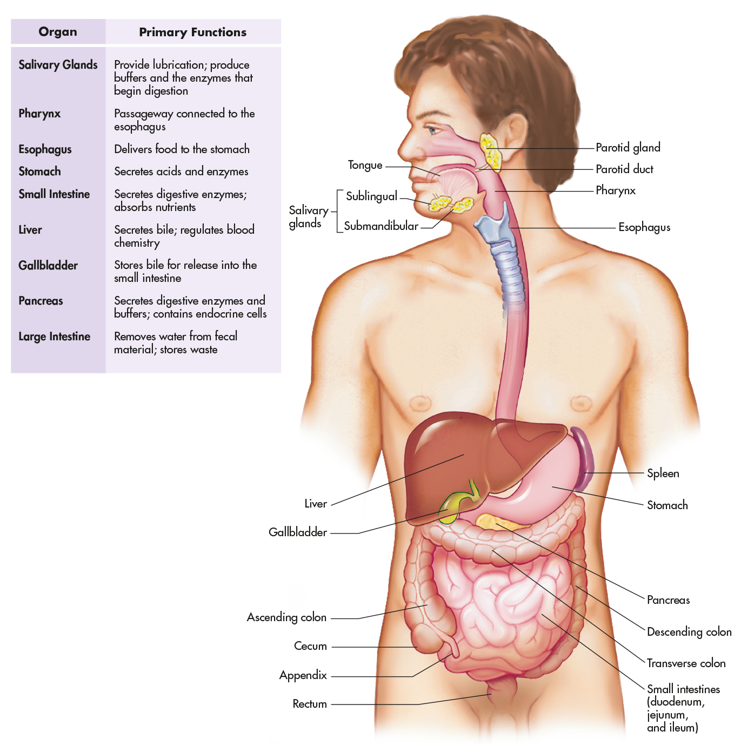
Figure 34-1 The digestive system.

Slide 6
Digestive System
Primary digestion
  Occurs in mouth
  Saliva contains digestive enzyme amylase
Esophagus
  25 cm long straight tube
  Food passes from pharynx to stomach
Final stages of chemical digestion
  Occur in small intestine
  Where almost all nutrients are absorbed
continued on next slide
continued on next slide

Slide 7
Digestive System
Excessive hydrochloric acid
  May break down gastric surface
  Then cause sores (ulcers)
Gastric ulcer = peptic ulcer
Peptic ulcer disease
  Most common disorder of the stomach
continued on next slide

Slide 8
Digestive System
Liver
  Center of body’s metabolic activity
Pancreas
  Secretes juice containing many digestive enzymes
continued on next slide

Slide 9
Digestive System
Small intestine
  Receives secretions from pancreas and liver
  Completes digestion
Large intestine
  Absorbs water, electrolytes
  Forms and stores feces

Slide 10
Peptic Ulcers
Caused by hyperacidity, excessive pepsin activity
Alcohol, caffeine, smoking linked to peptic ulcers
Many cases of gastric ulcers or gastritis due to Helicobacter pylori.

Slide 11
Table 34-1 Drugs Commonly Used in Peptic Ulcer Disease
GENERIC NAME | TRADE NAME | AVERAGE ADULT DOSAGE | ROUTE OF ADMINISTRATION
Antacids
aluminum hydroxide | Amphojel | 600 mg tid–qid | PO
calcium carbonate | Titralac, Tums | 1–2 g bid–tid | PO
calcium carbonate with magnesium hydroxide | Mylanta Gelcaps, Rolaids | 2–4 capsules or tablets prn (maximum: 12 tablets/d) | PO
magaldrate | Riopan | 480–1,080 mg (5–10 mL suspension or 1–2 tablets) 4 times/d (maximum: 20 tablets or 100 mL/d) | PO
tid, three times a day; qid, four times a day; PO, oral; bid, twice a day; IM, intramuscular; IV, intravenous.
continued on next slide

Slide 12
Table 34-1 Drugs Commonly Used in Peptic Ulcer Disease
GENERIC NAME | TRADE NAME | AVERAGE ADULT DOSAGE | ROUTE OF ADMINISTRATION
Antacids
magnesium hydroxide | Milk of Magnesia | 2.4–4.8 g (30–60 mL)/d in one or more divided doses | PO
magnesium hydroxide/aluminum hydroxide with simethicone | Maalox Plus | 10–20 mL prn (maximum: 120 mL/d) or 2–4 tablets prn (maximum: 24 tablets/d) | PO
sodium bicarbonate | Alka-Seltzer, and various trade names of baking soda | 0.3–2 g 1–4 times/d or 1/2 tsp of powder in a glass of water | PO
tid, three times a day; qid, four times a day; PO, oral; bid, twice a day; IM, intramuscular; IV, intravenous.
continued on next slide

Slide 13
Table 34-1 Drugs Commonly Used in Peptic Ulcer Disease
GENERIC NAME | TRADE NAME | AVERAGE ADULT DOSAGE | ROUTE OF ADMINISTRATION
H₂-Receptor Antagonists
cimetidine | Tagamet | 800 mg/d in divided doses 300 mg q6–8h | PO IM, IV
famotidine | Pepcid | 20–40 mg/d in divided doses 20 mg q12h | PO PO
nizatidine | (Generic only) | 300 mg at bedtime or in two divided doses | PO
tid, three times a day; qid, four times a day; PO, oral; bid, twice a day; IM, intramuscular; IV, intravenous.
continued on next slide

Slide 14
Table 34-1 Drugs Commonly Used in Peptic Ulcer Disease
GENERIC NAME | TRADE NAME | AVERAGE ADULT DOSAGE | ROUTE OF ADMINISTRATION
H₂-Receptor Antagonists
ranitidine | Zantac | 300 mg/d in two divided doses 50 mg q6–8h; 150–300 mg/24 h by continuous infusion | PO IV
Proton Pump Inhibitors
esomeprazole | Nexium | 20–40 mg/d | PO
lansoprazole | Prevacid | 15–30 mg/d | PO
omeprazole | Prilosec | 20–40 mg/d | PO
tid, three times a day; qid, four times a day; PO, oral; bid, twice a day; IM, intramuscular; IV, intravenous.
continued on next slide

Slide 15
Table 34-1 Drugs Commonly Used in Peptic Ulcer Disease
GENERIC NAME | TRADE NAME | AVERAGE ADULT DOSAGE | ROUTE OF ADMINISTRATION
Proton Pump Inhibitors
pantoprazole | Protonix | 40 mg/d for 8–16 wk 40 mg/d for 7–10 d | PO IV
rabeprazole | AcipHex | 20 mg/d | PO
Combination Medications
bismuth-tetracycline-metronidazole | (Generic only) | 1 blister pack/d for 14 d | PO
bismuth-ranitidine | Tritec | 1 blister pack/d for 14 d | PO
tid, three times a day; qid, four times a day; PO, oral; bid, twice a day; IM, intramuscular; IV, intravenous.
continued on next slide

Slide 16
Table 34-1 Drugs Commonly Used in Peptic Ulcer Disease
GENERIC NAME | TRADE NAME | AVERAGE ADULT DOSAGE | ROUTE OF ADMINISTRATION
Prostaglandins
misoprostol | Cytotec | 100–200 mcg qid with food | PO
tid, three times a day; qid, four times a day; PO, oral; bid, twice a day; IM, intramuscular; IV, intravenous.

Slide 17
Peptic Ulcers
Antacids
  Alkaline compounds
    Neutralize hydrochloric acid
  Most common types contain:
    Aluminum hydroxide
    Magnesium carbonate
  Counteract hyperacidity of stomach
    Protect from peptic ulcers
    Promote ulcer healing
continued on next slide

Slide 18
Peptic Ulcers
Antacids
  Adverse effects
    Diarrhea
    Constipation
    Anorexia
    Weakness
    Bone pain
    Tremors
continued on next slide

Slide 19
Peptic Ulcers
Antacids
  Contraindications
    Hypercalcemia
    Hyperparathyroidism
    Vitamin D overdosage
    Decalcifying tumors
    Severe renal disease
    Renal calculi
    Ventricular fibrillation
    Pregnancy
    Hypermagnesemia
continued on next slide

Slide 20
Peptic Ulcers
Antacids
  Interactions
    Digoxin
    Tetracyclines
    Ciprofloxacin
  Take antacids 1 to 3 hours after meals.
    And at bedtime
    Not within 1 to 2 hours of other oral medications
  Increase fluid intake to prevent kidney stones.
  Patients with cardiovascular disease should void antacids that are high in sodium.
continued on next slide

Slide 21
Peptic Ulcers
H₂-Receptor Antagonists
  Reduce secretion of gastric acid
    By blocking H₂-receptors
  Used in
    Short-term treatment of active duodenal ulcers
    Prevention of ulcer recurrence
    Also for heartburn
continued on next slide

Slide 22
Peptic Ulcers
H₂-Receptor Antagonists
  Adverse effects
    GI disturbances
    Headache
    Drowsiness
    Confusion
    Agitation
    Hallucinations
    Impotence
continued on next slide

Slide 23
Peptic Ulcers
H₂-Receptor Antagonists
  Contraindications
    Hypersensitivity
    Pregnancy
    Lactation
    Children under 16
  Interactions
    None listed
  Warn patients to avoid smoking and drinking alcohol.
continued on next slide

Slide 24
Peptic Ulcers
Proton Pump Inhibitors
  Block hydrochloric acid production
  Used to heal stomach and duodenal ulcers
  Also to relieve symptoms of:
    GERD
    Esophagitis
continued on next slide

Slide 25
Peptic Ulcers
Proton Pump Inhibitors
  Adverse effects
    Headache
    Dizziness
    Fatigue
    Diarrhea
    Abdominal pain
    Nausea
    Rash
    Rarely hematuria
continued on next slide

Slide 26
Peptic Ulcers
Proton Pump Inhibitors
  Contraindications
    Hypersensitivity
    Children
    Pregnancy
    GI bleeding
    Long-term use for GERD or duodenal ulcers
  Interactions
    None listed
  That treatment is for short term only
    4–8 weeks
continued on next slide

Slide 27
Peptic Ulcers
Prostaglandins
  Affect GI motility and gastric acid secretion
  Administered to prevent complications of gastric ulcers resulting from NSAID use
  Adverse effects
    Diarrhea
    Menorrhagia
continued on next slide

Slide 28
Peptic Ulcers
Prostaglandins
  Contraindications
    Pregnancy
    Lactation
    History of allergies to these drugs
  Interactions
    None listed
  Women must immediately report pregnancy.
  Diarrhea may occur will disappear after the first month of therapy.

Slide 29
Diarrhea
  Increase in the following, of bowel movements relative to usual pattern:
  Volume
  Fluidity
  Frequency
  Usually self-limiting
Drugs include:
  Opioids
  Adsorbents
  Synthetic opioid medications

Slide 30
Table 34-2 Classifications of Antidiarrheal Drugs
GENERIC NAME | TRADE NAME | TYPE | COMMENTS
bismuth subsalicylate | Pepto-Bismol | Adsorbent | OTC
camphorated opium tincture (paregoric) | (Generic only) | Opioid | Schedule III
difenoxin hydrochloride with atropine sulfate | (Generic only) | Opioid | Schedule IV
diphenoxylate hydrochloride with atropine sulfate | Lomotil | Opioid | Schedule IV
Note: Formerly, kaolin with pectin was a combination medication used as an adsorbent, but this combination is no longer available in the United States. OTC, over the counter.
continued on next slide

Slide 31
Table 34-2 Classifications of Antidiarrheal Drugs
GENERIC NAME | TRADE NAME | TYPE | COMMENTS
loperamide | Imodium, Maalox Anti-Diarrheal | Opioid | OTC (abuse is very low, and it is not classified as a controlled substance)
Note: Formerly, kaolin with pectin was a combination medication used as an adsorbent, but this combination is no longer available in the United States. OTC, over the counter.

Slide 32
Diarrhea
  Opioid and Synthetic Opioid Drugs
  Narcotic analgesics act as stimulants on opioid receptors in GI tract to:
    Increase mixing movements of gut
    Decrease peristaltic movements
  Administered to treat diarrhea
continued on next slide

Slide 33
Diarrhea
  Opioid and Synthetic Opioid Drugs
  Adverse effects
    Constipation
    Nausea, vomiting
    Agitation
    Drowsiness
    Tachycardia
    Hand and foot numbness
continued on next slide

Slide 34
Diarrhea
  Opioid and Synthetic Opioid Drugs
  Contraindications
    Intestinal obstruction
    Children under age 6
    Not to be used for chronic diarrhea
  Interactions
    None listed
continued on next slide

Slide 35
Diarrhea
  Opioid and Synthetic Opioid Drugs
  Patients must keep a record of bowel movements.
    To determine effectiveness or possible constipation
  Patients must drink clear fluids for a few days.
    Avoid fruit juices and alcohol.
continued on next slide

Slide 36
Diarrhea
  Absorbents
  Absorb toxins in GI tract that might be causing diarrhea
  Usually taken after each loose bowel movement until diarrhea is controlled
  Adverse effects
    Mild, transient constipation
continued on next slide

Slide 37
Diarrhea
  Absorbents
  Contraindications
    Pseudomembranous colitis
    Diarrhea due to toxins
    Fever
    Use for more than 48 hrs
    Suspected obstructive bowel lesions
continued on next slide

Slide 38
Diarrhea
  Absorbents
  Interactions
    Chloroquine
    Digoxin
    Penicillamine
    Tetracycline
    Ciprofloxacin
    Many others
continued on next slide

Slide 39
Diarrhea
  Absorbents
  Do not exceed prescribed dosages.
  Notify physician if:
    Diarrhea not controlled in 48 hours.
    If fever develops.
  Avoid breastfeeding.

Slide 40
Constipation
Often caused by dehydration
Non-dietary constipation can be caused by:
  Paralytic ileus after abdominal surgery
  Antimuscarinic drugs
Laxatives are among the most misused drugs.

Slide 41
Table 34-3 Categories of Laxatives
GENERIC NAME | TRADE NAME | AVERAGE ADULT DOSAGE | ROUTE OF ADMINISTRATION
Osmotic Laxatives
lactulose | Cephulac | 30–60 mL/d prn | PO
magnesium citrate | Citrate of Magnesia, Citroma | 240 mL/d in 8 oz of water | PO
magnesium hydroxide | Milk of Magnesia | 2.4–4.8 g (30–60 mL)/d in 1 or more divided doses | PO
magnesium sulfate | Epsom Salt | 10–15 g/d in 8 oz of water | PO
PO, oral; bid, twice a day; qid, four times a day.
continued on next slide

Slide 42
Table 34-3 Categories of Laxatives
GENERIC NAME | TRADE NAME | AVERAGE ADULT DOSAGE | ROUTE OF ADMINISTRATION
Stool Softeners
docusate calcium | Surfak | 50–500 mg/d | PO
docusate potassium | Dialose | 50–500 mg/d | PO
docusate sodium | Colace | 50–500 mg/d 50–100 mg added to enema fluid | PO Rectal
glycerin | Glycerol, Osmoglyn | Insert 1 suppository of 5–15 mL of enema high into rectum and retain for 15 min | Rectal
PO, oral; bid, twice a day; qid, four times a day.
continued on next slide

Slide 43
Table 34-3 Categories of Laxatives
GENERIC NAME | TRADE NAME | AVERAGE ADULT DOSAGE | ROUTE OF ADMINISTRATION
Stimulant Laxatives
bisacodyl | Apo-Bisacodyl, Dulcolax | 5–15 mg prn (maximum: 30 mg for special procedures) 10 mg prn | PO Rectal
cascara sagrada | Cascara Sagrada Aromatic Fluid-extract, Cascara Sagrada Fluidextract | Tablets: 325–1,000 mg/d Aromatic Fluidextract: 2–6 mL/d; Fluidextract: 0.5–1.5 mL/d | PO
PO, oral; bid, twice a day; qid, four times a day.
continued on next slide

Slide 44
Table 34-3 Categories of Laxatives
GENERIC NAME | TRADE NAME | AVERAGE ADULT DOSAGE | ROUTE OF ADMINISTRATION
Stimulant Laxatives
senna (sennosides) | Black-Draught, Senokot | Standard concentrate: 1–2 tablets or 1/2–1 tsp at bedtime (maximum: 4 tablets or 2 tsp bid); syrup: 10–15 mL at bedtime | PO
PO, oral; bid, twice a day; qid, four times a day.
continued on next slide

Slide 45
Table 34-3 Categories of Laxatives
GENERIC NAME | TRADE NAME | AVERAGE ADULT DOSAGE | ROUTE OF ADMINISTRATION
Bulk-Forming Laxatives
calcium polycarbophil | FiberCon, Mitrolan | 1 g qid prn (maximum: 6 g/d) | PO
psyllium hydrophilic mucilloid | Metamucil | 1–2 rounded tsp or 1 packet 1–3 times/d prn | PO
PO, oral; bid, twice a day; qid, four times a day.

Slide 46
Constipation
Osmotic Laxatives
  Sodium and magnesium ions
    Attract water into bowel
    Causing a more liquid stool
  Adminstered for:
    Short-term treatment of occasional constipation
continued on next slide

Slide 47
Constipation
Osmotic Laxatives
  Adverse effects
    Nausea, vomiting
    Cramps
    Diarrhea
    Weakness
    Lethargy
    Electrolyte imbalance
continued on next slide

Slide 48
Constipation
Osmotic Laxatives
  Adverse effects
    Hypotension
    Bradycardia
    Depression
    Coma
continued on next slide

Slide 49
Constipation
Osmotic Laxatives
  Contraindications
    Renal impairment
    Hypertension
  Interactions
    None listed
  24 to 48 hours are needed for effect to occur.
  Avoid breastfeeding.
continued on next slide

Slide 50
Constipation
Stool Softeners
  Also called emollients or surfactants
  Basically hold water in fecal material
    Making it softer and easier to pass
  Work very slowly, over days
  Administered for:
    Easing bowel movements in constipated patients.
    Prophylactic use in those who should avoid straining.
continued on next slide

Slide 51
Constipation
Stool Softeners
  Adverse effects
    Mild abdominal cramps
    Diarrhea
    Nausea
    Bitter taste
continued on next slide

Slide 52
Constipation
Stool Softeners
  Contraindications
    Atonic constipation
    Nausea and vomiting
    Abdominal pain
    Intestinal obstruction or perforation
  Interactions
    Mineral oil
continued on next slide

Slide 53
Constipation
Stool Softeners
  Take sufficient liquids with each dose.
    Increase fluid intake during the day.
  Not for prolonged dietary management
continued on next slide

Slide 54
Constipation
Laxative Stimulants
  True purgatives
    Directly affect walls of small or large intestine
    Cause increase in peristaltic movements
      Leading to defecation
  Administered for:
    Temporary relief of constipation in various disease conditions
    To prevent straining
      Sometimes used with magnesium hydroxide
continued on next slide

Slide 55
Constipation
Laxative Stimulants
  Adverse effects
    Anorexia
    Nausea
    Gripping
    Abnormally loose stools
    Constipation rebound
    Melanosis of the colon
    Discoloration of urine
    Hypokalemia
continued on next slide

Slide 56
Constipation
Laxative Stimulants
  Contraindications
    Abdominal pain
    Fecal impaction
    GI bleeding
    Ulcerations
    Appendicitis
    Intestinal obstruction
    Pregnancy
    CHF
continued on next slide

Slide 57
Constipation
Laxative Stimulants
  Interactions
    Oral anticoagulants
  Frequent or prolonged use disrupts normal reflex activity of colon and rectum.
    This leads to drug dependence for evacuation.
continued on next slide

Slide 58
Constipation
Bulk-Forming Laxatives
  Add bulk to colonic contents
    Stimulating forward-propulsive movements
    Defecation reflex
  Absorb free water in intestinal tract
    Oppose dehydrating forces of bowel
      Forming a gelatinous mass
  Administered for:
    Chronic atonic or spastic constipation
    Or when associated with rectal disorders or anorectal surgery
continued on next slide

Slide 59
Constipation
Bulk-Forming Laxatives
  Adverse effects
    Nausea, vomiting
    Diarrhea (with excessive use)
    Abdominal cramps
continued on next slide

Slide 60
Constipation
Bulk-Forming Laxatives
  Contraindications
    Nausea and vomiting
    Fecal impaction
    Abdominal pain
    Appendicitis
    Children under age 2
    Esophageal and intestinal obstruction
continued on next slide

Slide 61
Constipation
Bulk-Forming Laxatives
  Interactions
    Antibiotics
    Warfarin
    Digoxin
    Nitrofurantoin
    Salicylates
continued on next slide

Slide 62
Constipation
Bulk-Forming Laxatives
  Patients on low-sodium or low-calorie diets
    Be aware of sugar, sodium content
  May reduce appetite before meals
  Avoid breastfeeding.

Slide 63
Vomiting
Disgorging contents of stomach through mouth (emesis)
Triggered by:
  Infections
  Drugs
  Radiation
  Chemotherapy
  Surgery
continued on next slide

Slide 64
Vomiting
Emetics
  Intensely irritate mucosal layer of intestinal wall
  Use of ipecac syrup as an emetic
    Has largely declined
continued on next slide

Slide 65
Vomiting
Emetics
  Adverse effects
    Stiff muscles
    Severe myopathy
    Convulsions
    Coma
    Arrhythmias
    Chest pain
    Dyspnea
    Hypotension
    Fatal myocarditis
continued on next slide

Slide 66
Vomiting
Emetics
  Contraindications
    Comatose, semi-comatose, or deeply sedated patients
    Shock
    Seizures
    Impaired cardiac function
  Interactions
    None listed
continued on next slide

Slide 67
Vomiting
Emetics
  Before using ipecac syrup, instruct patients or their families to call:
    Emergency department
    Poison control center
    Physician
  Avoid breastfeeding.
continued on next slide

Slide 68
Vomiting
Antiemetics
  Prevent or relieve nausea and vomiting
  Administered for:
    Motion sickness
    Post-radiation or chemotherapy vomiting
continued on next slide

Slide 69
Vomiting
Antiemetics
  Adverse effects
    Drowsiness
    Confusion
    Dry mouth
    Headache
    Hypotension
    Hypersensitivity reactions
    Blurred vision
continued on next slide

Slide 70
Vomiting
Antiemetics
  Contraindications
    Hypersensitivity
    Coma
    Severe CMS depression
    Pregnancy
    Lactation
  Interactions
    Dopamine
continued on next slide

Slide 71
Vomiting
Antiemetics
  Avoid driving, and operating heavy machinery.
  Avoid alcohol.
  Especially avoid during first trimester of pregnancy.
  For motion sickness, take 30 minutes before travel.

Slide 72
Table 34-4 The Most Commonly Used Antiemetics
GENERIC NAME | TRADE NAME | AVERAGE ADULT DOSAGE | ROUTE OF ADMINISTRATION
Dopamine Antagonists
haloperidol | Haldol | 1–2 mg q12h | PO
chlorpromazine | Thorazine | 10–25 mg q4–6h | PO, IM, IV
perphenazine | Perphenazine Tablets | 8–16 mg/d | PO
prochlorperazine | Compazine | 5–10 mg tid–qid | PO, IM, IV, rectal
promethazine | Phenergan | 25 mg q4–6h | PO, IM, IV, rectal
thiethylperazine | Torecan | 10 mg 1–3 times/d | PO, IM, rectal
PO, oral; IM, intramuscular; IV, intravenous; tid, three times a day; qid, four times a day.
continued on next slide

Slide 73
Table 34-4 The Most Commonly Used Antiemetics
GENERIC NAME | TRADE NAME | AVERAGE ADULT DOSAGE | ROUTE OF ADMINISTRATION
Miscellaneous Agent
metoclopramide | Reglan | 1–2 mg/kg 30 min before chemotherapy and q2–4h prn | IV
Serotonin Antagonists
granisetron | Kytril | 1 mg 1 h before chemotherapy | PO, IV
ondansetron | Zofran | 4–8 mg tid | PO, IV
PO, oral; IM, intramuscular; IV, intravenous; tid, three times a day; qid, four times a day.
continued on next slide

Slide 74
Table 34-4 The Most Commonly Used Antiemetics
GENERIC NAME | TRADE NAME | AVERAGE ADULT DOSAGE | ROUTE OF ADMINISTRATION
Antihistamines
dimenhydrinate | Dramamine | 50–100 mg q4–6h prn | PO, IM, IV
diphenhydramine | Benadryl | 10–50 mg q4–6h prn | PO, IM, IV
hydroxyzine | Atarax, Vistaril | 25–100 mg q6h prn | PO, IM
meclizine | Antivert | 25–50 mg/d | PO
Anticholinergics
scopolamine | Transderm-Scop | 0.5 mg q72h | Transdermal
trimethobenzamide | Tigan | 250 mg tid–qid | PO, rectal
PO, oral; IM, intramuscular; IV, intravenous; tid, three times a day; qid, four times a day.

